Slide 1
Calorie Care

Slide 2

Course Title : Mobile Application Lab
Course Code : 426-CSE
Presented To
Presented By
K.M Shadman Wadith
Lecturer
Dept. Computer Science and Engineering
Monjurul Hasan ( 193002180 )
M A S K Shakil (201002029)
Dept. Computer Science and Engineering

Slide 3
Table of contents
01
02
03
04
05
06
07
08
Introduction
Objective
Project Features
Tools & Technology
Implementation
Future Scope
Conclusion
Demonstration

Slide 4
01
Introduction

Slide 5

Introduction
Calorie Care is a unique diet planning mobile application created to meet the nutritional demands . The software is developed in Java for Android, provides individualized meal planning based on local cuisines and individual nutritional needs. Calorie Care's user-friendly design and comprehensive database of Bangladeshi meals enable users to easily track their calories and maintain a balanced diet.

Slide 6
02
Objective

Slide 7
Objective
To offer individualized meal plans that adapt to users' dietary preferences and nutritional needs.
To provide a complete database of Bangladeshi cuisine that allows for precise calorie tracking and nutritional data.
To provide a user-friendly interface for meal planning and calorie tracking.
To promote good eating habits and assist people in meeting their health and fitness objectives.

Slide 8
03
Features

Slide 9
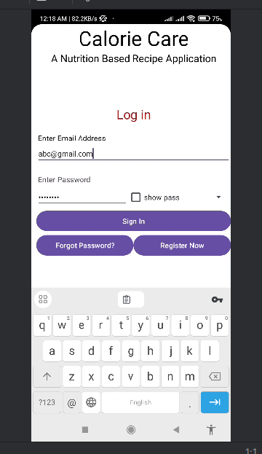
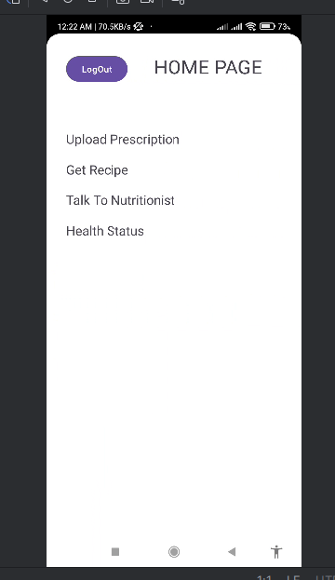

Slide 10
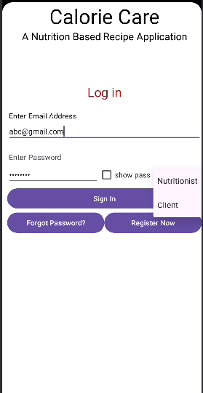
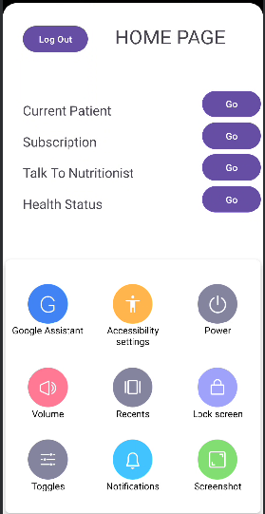

Slide 11
04
Tools & Technology

Slide 12



Tools & Technology

Slide 13
05
Implementation

Slide 14
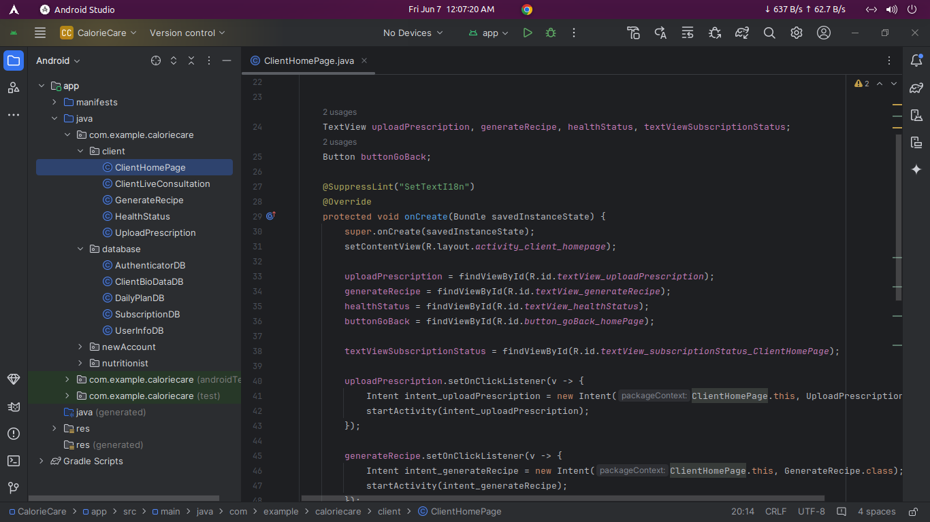
Project Implementation: Client

Slide 15
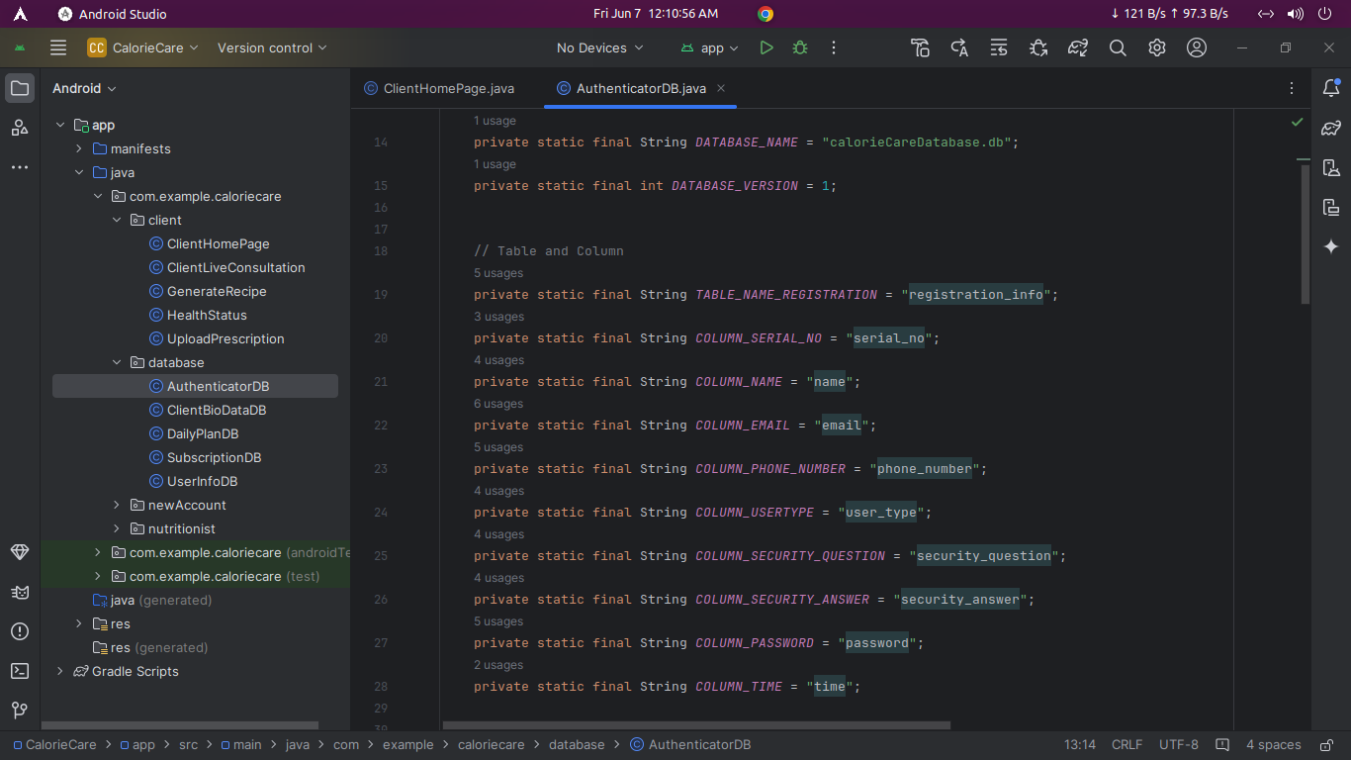
Project Implementation: Database

Slide 16
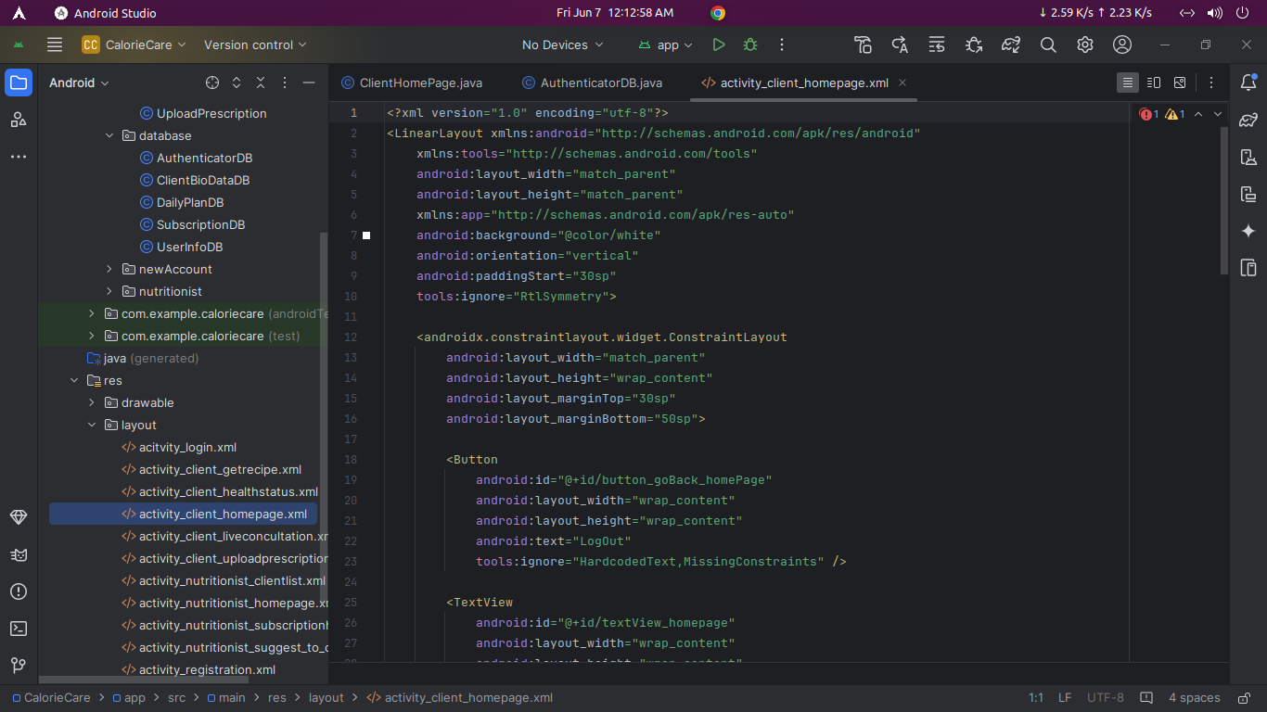
Project Implementation: XML

Slide 17
06
Future Scope

Slide 18
Future Scope
Artificial intelligence (AI) algorithm integration for improved meal suggestions and customized nutrition schedules.
A greater range of local, regional, and global cuisines are added to the food database.
Adding functionality to track micronutrients and offer thorough nutritional analysis.
Working together with health and fitness trackers to provide users with seamless integration and detailed health monitoring.

Slide 19
07
Conclusion

Slide 20
Conclusion
Calorie Care is ready to change the way Bangladeshis approach their diet and nutritional goals. It provides an extensive tool for keeping a healthy diet, with tailored meal plans, a huge food database, and an easy-to-use interface. Calorie Care remains devoted to supporting healthier living and empowering consumers to take control of their health as it evolves with advances such as AI integration and fitness tracking.

Slide 21
08
Demonstration

Slide 22


Slide 23


